Slide 1
THE PROGRAM
Overtime Athletics

Slide 2
Youth Sports and Activity Programs
Being an expert in the sales, operations, and customer service of youth programming is essential in order to achieve a favorable reputation amongst communities
This process of becoming an expert begins with an understanding of THE PROGRAM
  Program Catalogue
  Curriculum, Programming Day Card
  Class Procedure, Instructors, Equipment and Gear
  Program Formula and Process to Partner with Schools and other community organizations
  Important Programming Information

Slide 3
Program Catalogue
“The Menu”

Slide 4
Program Catalogue
Franchisees should know the Program Catalogue backwards and forwards. It is the bases of our service. Understanding how to describe, market, sell, and answer questions from Partnering Contacts (PTA Coordinators, Principals, Youth Directors, Sports Departments, etc.) is essential. Just telling someone what is in the program description is not sufficient.
Understanding that customers expectations will stem from what is described in a program description is the first step in avoiding a service issue.
You must provide participants and families what was sold to them.
Our Program Catalogue for organizational purposes and ease of description is split up into categories: “WINNNERS”, “CLASSIC”, and “FAVORITES”
NOTE: Refer to Catalogue to review Program Descriptions

Slide 5
WINNERS:
OTA’s most popular programs
Sports Spectacular Variety Program
Let’s Play! Save the best for last by finishing up the school day with Sports Spectacular, a variety athletic program that features different sports throughout the session. Participants will practice skills and play games in both traditional sports and playground favorites. The Sports Spectacular Variety Program features the best “to-do” list ever – Basketball, Soccer, Flag Football, Kickball, Capture the Flag, Wiffle Ball, Bump and Bite, Knights and Dragons, Numbers Game, Tag Games, Safe Base and MORE! OTA covers all the bases with our emphasis on playing, teamwork, sportsmanship, and fitness. Don’t miss out on the FUN!
Gotime (Game Play and Scrimmaging)
Play Ball! Come join OTA for our ALL games ALL the time after school program. GOtime’s exclusive game-play format features a variety of sports (Basketball, Soccer, Flag Football, etc.) and will be structured as a REAL GAME from start to finish. Loosen up, warm-up, and choose up sides, then get ready to play! Coaches will organize each game to teach kids the rules of competition, team play, and sportsmanship. We have always believed athletes get better the more they play. Here is your chance! This organized scrimmage every week will give players the opportunity to test new skills and get more comfortable in game situations. Come be a part of our TEAM!

Slide 6
CLASSIC:
Traditional Sports Offerings
Fast Break Basketball
Shooting Stars Soccer
Go Long Flag Football
Big Swing Wiffle Ball
Lax-Tastic Lacrosse
Slap Shots Floor Hockey
Kids Tennis Club
Pitch and Putt Golf

Slide 7
FAVORITES:
Playground and Gym Class “Hero's”
Kaboom Kickball
Head’s Up Dodgeball
Jump For Joy Jump Rope
Cheer-IT With Spir-it Cheerleading
(and Jump Rope)
iSprint Speed and Agility Program
Scooter Dash
Parachute Play
HIGH FIVES Running Club
Countdown (minute to win it)
Connect 4 vs Checkers
GAGA
Pickleball
Handball

Slide 8
The “Double Play” Option:
Combination Programs
Flexibility is a centerpiece of OTA’s customer service. One of the ways we achieve this is by providing Coordinators an option to select two activities to be run as one program for the session.
For Example: Double Play of Soccer and Basketball
  The Program will have an equal number of classes focusing on each activity
  Often alternating activities each week
Being on the same page regarding these logistics is essential for Instructors, Coordinators, and Parents/Kids in order to avoid some sort of disappointment or lack of preparedness (and organization) of how the session will run.

Slide 9
The Curriculum
“The Parts of the Game”

Slide 10
Curriculum Note:
*In addition to each Program’s Curriculum, you can find sections on “General Games” and “Field Day”
The General Games section of the curriculum includes:
  Tag Games
  Ball Games
  Elementary Games
  Motion Games
  Big Games
  Low Intensity / Rainy Day Games
OTA Field Day Options (strategies)
  Olympic Style
  Station Style
  Theme Style

Slide 11
Curriculum Parts
Each section of the OTA Curriculum has (at least) four parts:
  Program Description Outline
    Description
    Skills to Focus on
    Facility Notes
    Safety Concerns
    Tips
  Skills / Drills
  Games
  Sample PDC’s (First 4 PDC’s)

Slide 12
The Programming Day Card
“The PDC”

Slide 13
THE PROGRAMING DAY CARD (PDC)
The Programing Day Card is an Instructors Lesson Plan for Each Class

Slide 14

OUR FORMULA WORKS EVERYTIME
OTA has created a formula that, when followed properly, will give each instructor the proper tools in order to achieve a successful program.

Slide 15
THE PDC
Programming Day Card
Warm Up (5-7mins):
Skill/Review (5-7min):
Drill (5-7min):
Games (30-45min):
1.
2.
3.
4.
5.
Things to Consider:
Facility, Age Group, Enrollment, Skill Level, Equipment, Duration of Class
The PDC is designed with the coach and class in mind.
What does the PDC Do?
It is a way for coaches to:
Think ahead and prepare for class
Organize activities
Plan games
You do not need to be an expert in a sport or activity to successfully run class. By reading the curriculum as well as following your PDC, you will seem like a pro in each class you coach

Slide 16
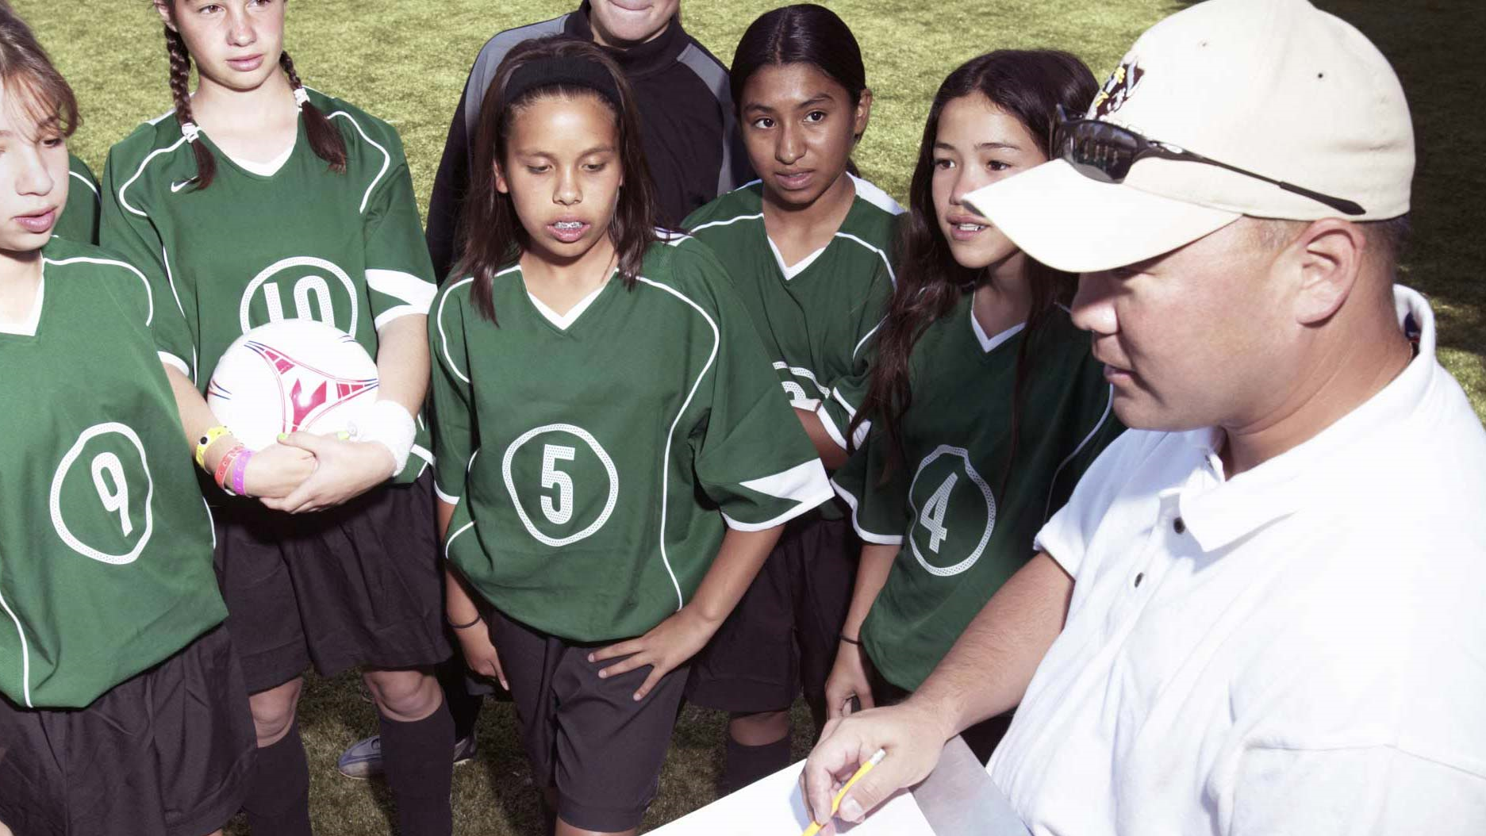
THE PDC
The more familiar you become with OTA standards and activities, the easier it will be to complete the PDC and run effective and fun classes.

Slide 17

THE PDC
The PDC is composed of 4 parts:
The Warm Up
Skill
Drills
Games

Slide 18
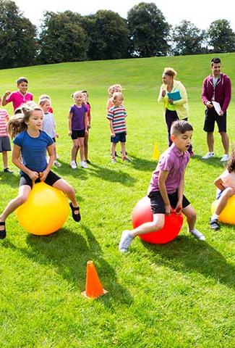
The Warm Up Game
The warm up game should be your first game of the class
This game should be designed to get everyone:
  Involved
  Participating
  Excited
Remember: The warm up game should be last somewhere between 5 minutes and 7 minutes.
*This game does not need to relate to your sport of the day*

Slide 19
Skill and Drills
Each class you should be introducing a new skill and a new set of drills for each student to practice and master.
These should be fundamental elements to the assigned sport of the program.
Be creative when constructing drills for your class. The more creative the drill, the more you keep the class focused and motivated.
Keep the drills easy enough for the class to do, but not without effort and challenge.

Slide 20
GAMES
Half of class time should be spent playing games (30-45 minutes)
Try to come up with games that incorporate what the kids learned during the skill/drill segment
Explain rules clearly and start simple. Make teams as fair as can be
Example
Drill: Dribble Lines
Games:
Dribble Tag
Red light- Green Light
Dribble Knockout

Slide 21
OTA TEMPLATE
Programming Day Card
Warm Up (5-7mins):
Skill/Review (5-7min):
Drill (5-7min):
Games (30-45min):
1.
2.
3.
4.
5.
Things to Consider:
Facility, Age Group, Enrollment, Skill Level, Equipment, Duration of Class
Available on the OTA Instructor website located in Staff log-in Section
Coaches can input games and activities directly onto the card and print off for class

Slide 22
Class Procedure
“The Format”

Slide 23
Overtime Athletics Rules of the Game!
Instructor Guidelines:
** Must be wearing Overtime Athletics T-shirt!
** Must arrive to school 15 minutes before class starts
**Must notify if running behind schedule
**Sign in at front office
Beginning of Class:
Bring Instructor Folder and Instructor Bag to every class
Take attendance everyday and mark students absent if necessary
Keep attendance sheet in Instructor Folder
During Class:
Be aware of everything that is going on around class
Conduct a head count every 15 minutes
Give HIGH FIVES!
End of Class:
Overtime Athletics Instructors may not leave until every student is accounted for
Instructors may leave if there is a PTA monitor in charge of the student’s dismissal
Consolidate students and follow Overtime Athletics dismissal procedure
Inventory equipment and make sure the programming space is how you found it or better

Slide 24
Step 1 – Arrive to School on Time
Wearing Uniform
In Possession of OTA Equipment/
Instructor Bag/Instructor Folder
Programming Day Card (Lesson Plan)
Step 2 – Check in at School Office 15 Minutes Prior to Class
Step 3 – Make Sure Class Space is Safe
Step 4 – Set up Games, Drills, Stations, Equipment
Step 5 – Welcome Students / Line up Book Bags
Step 6 – Line-Up/Huddle-Up INTRO’s
Introduce Instructors
Introduce Program
Introduce Kids (Take Attendance)
Head COUNT
Step 7 – OTA RULES
Step 8 – Warm-Up *HIGH FIVES/Trivia
Step 9 – Skill *Water Breaks/Trivia
Step 10 – Drill *1-on-1 Moment/Trivia
Head COUNT
Step 11 – Games/Scrimmages *Sportsmanship/Trivia
Step 12 – Close Out
Line-Up/Huddle Up
Head COUNT
Themes Talk – Sportsmanship, Fair Play, Health/Nutrition, etc
Announcements and Handouts
Step 13 – Dismissal
Step 14 – Clean Up Space
Step 15 – If there was a Problem or Injury, notify PTA Coordinator/OTA Office
Step 16 – See Ya Next Time!

Slide 25
OTA Instructors
“The Team”

Slide 26
The Instructor Job Description
Title: Instructor
An OTA Instructor Must:
  Have experience working with kids
  Be comfortable working in an athletic setting
  Have some knowledge of sports
  Be available to work afternoons
  Have your own transportation
  Be punctual
  Be professional
  Be patient
  Implement high-energy and fun classes
Work Environment:
  This is a part-time position.
  You will use your own transportation to drive to the schools.
  There are mandatory trainings and staff meetings.
Job Logistics:
  Each instructor is responsible for their issued equipment bags.
  Classes are split into grades (younger and older groups)
  Classes are usually between 10-20 kids
  Pay is HOURLY

Slide 27
Who Are OTA Instructors?
Who is on the OTA TEAM?
Our staff primarily consists of undergraduate and graduate students from local universities and colleges.
How do you make the OTA TEAM?
Our Instructors have previous experience working with children.
All of our coaches have athletic backgrounds.
They have passed a background check.
What type of training do OTA Instructors go through?
Our Instructors go through an extensive process including: hiring appointments, shadowing sessions, and multiple training appointments before they teach a class.
They are experts on implementing the OTA Curriculum.
They have reviewed our company manual, learned our training manual, completed our training booklet, and utilize their Instructor folder.
They must periodically attend training sessions and complete tutorials throughout their OTA employment.

Slide 28
What is expected of an OTA Coach during class?
They arrive 15 minutes before the class is scheduled to begin and stay until the last child is picked up.
They will have the following things: a uniform, equipment, and a first aid kit.
They will have a completed programming day card (lesson plan) for the class/activity.

Slide 29
Equipment and Gear
“The Tools”

Slide 30
Equipment Issuing and Inventory
Directors are responsible for seeing to it that each instructor has the necessary equipment to run successful classes (reference Equipment List).
The need for equipment in each program should always be cross-referenced with enrollment numbers.
Directors should regularly check in with Instructors on the status of their equipment. Staff Meetings, Cont. Training Appointments, Check In Emails are all opportunities to discuss the status of issued equipment or equipment needs.
Monitoring equipment during program evaluations is a must in order to evaluate the level of professionalism and commitment each instructor exhibits.

Slide 31
Flat equipment, damaged equipment, missing equipment should always be a part of the conversation with staff and always reconciled as soon as possible.
Recording the equipment each instructor is in possession of is the responsibility of the program director.
Equipment Bags should be inventoried upon their return by Instructors.
  The Instructor Backpack and Instructor Folder should also be returned and inventoried at the end of the school year or when an instructor leaves the Staff Roster.
  Be sure to remind Instructors of this policy prior to meeting with them for their exit meeting or equipment return appointment.

Slide 33
Program Formula
“The System and Process”

Slide 34
Becoming an Expert
When can our school run an Overtime Athletics program?
Overtime Athletics runs fall, winter and spring sessions for a period of 4-12 weeks. Each program is one hour in length once a week after school. Your school chooses the start time of the program and the weeks that the program will run.
What is the minimum and maximum enrollment for each program?
This depends on a variety of factors; mainly what type of space is available. Our minimum enrollment for each program is 10 kids, and our maximum is around 30. If there is ample space, we may be able to accommodate more than 30 participants.
How many programs can our school sign up for?
Depending on what space is available during the week, you can sign up for as many as you wish! If you want a program and you have the space, Overtime Athletics can accommodate your needs.

Slide 35
Does Overtime Athletics separate the participants by grade level?
Yes. Overtime Athletics separates the groups into K - 2nd and 3rd - 5th grades, or 1st - 3rd and 4th - 6th grades. Overtime Athletics can also provide a class just for the Kindergarten students.
Does our school need to provide parent/teacher volunteers?
No. Overtime Athletics provides the Instructor/s for each class.
Does Overtime Athletics provide information that can be given to parents and children?
Yes. We provide the school with copies of our brochure, a blurb for the newsletter/brochure, and flyers/postcards describing what programs are available.
Our school already has after school programs with the YMCA, Parks and Rec, SACC, and general after care. Can we still schedule an Overtime Athletics program?
Yes! We run our programs anywhere from the gym, to a field, blacktop, cafeteria, and even classrooms. The Director in your area will help you decide the appropriate space for the class you want to offer.

Slide 36
Promoting OTA’s Service
Curriculum focuses on getting kids moving and having fun
OTA Provides Equipment
Classes are held at the school – safe and familiar space for students
Instructors are trained and have cleared a background check
Classes are grade level appropriate
Wide selection of activities in our Program Catalogue
Skill Development and Game Play
Sportsmanship and Teamwork Focus
Make new friends, play with old ones
Flexible and friendly service

Slide 37
The Process to Become a Partner
School (Partner)
  Choose Activity
  Choose Day for Program
  Choose Number of Weeks
  Secure Space
Overtime Athletics
  Create and Provide copies to schools for distribution to families
  Set up registration for parents to sign up students
  Provide roster to school once registration closes
  Send welcome email to families prior to first day of program

Slide 38
Confirming Program Details:
What to Know
Communicating with Partners:
Can we handout flyers to schools?
Do we submit a Program Description?
Who handles the registration process?
When does registration close?
*Confirmation emails and Paper Trails that address the information outlined here is essential between OTA and Partner Contact to maintain organization
Important Info To Know:
Participating Grades
Days – Dates – Times
Enrollment Minimum/Maximum
Enrollment Number
Participation Fee
Instructor Clearance Guidelines
Payment Timeline (if there wasn’t online registration

Slide 39
The Perfect Program
“The Goal”

Slide 40
Understanding Customer Expectations
OTA has created a “Customer Bill of Rights” to help our organization understand, prepare for, and respond to the expectations from our Partnering Schools and Organizations, Parents, and Kids. Franchisees should review these expectations regularly until a level of expertise has been achieved.
Striving for perfection is something that leads to greater profitability.
Reviewing and understanding the factors relating to providing a “perfect program” is an essential step in customer service.
You will notice that MOST of the checklist that follows pertains to the preparation and organization of providing a program, much of which doesn’t have anything to do with actually working with and coaching the participants.
Participant experience of course is the centerpiece of youth programming, without providing a positive experience, nothing else is achievable in the long run.

Slide 41
The Checklist for determining whether we provided a
“perfect program”
Prepared Attendance Sheets/Rosters
Qualified/Trained Instructors
Proper Coach/Participant Ratio
Proper Equipment
Proper Attire
Instructors Always on Time
Same Instructors Working Programs
Organized Arrival, Water, and Bathroom Breaks
Successful Dismissal Procedure
Respect for Facility and Clean Up
Organized (PDC’s filled out)
Safe
Fun and Energetic
Teaching Skills
Playing Games/Scrimmages
Activity Offered Matches Program Description
Reporting Behavior or Injury Issues
Management Presence
Flexible Service
Professional and Friendly Service

